Slide 1




DeepSpeech
Abdullah Alsalhi
Rakan Alharbi

Slide 2
Agenda
Introduction
What is DeepSpeech?
Key Fetures
Applications & Example
Conclousin

Slide 3
Introduction
Welcome to our presentation on DeepSpeech, the leading technology in converting speech to text using artificial intelligence techniques.
DeepSpeech is an open-source model developed by Mozilla, based on deep neural network technologies.

Slide 4

DeepSpeech is a machine learning model built on deep neural networks.
DeepSpeech enables the conversion of natural language speech into accurately transcribed text.
What is DeepSpeech?
It relies on deep learning and machine learning techniques to achieve superior performance in speech understanding.

Slide 5
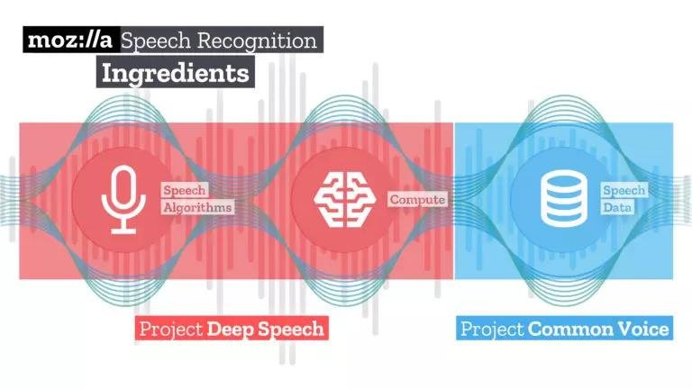
Key Features
High accuracy.
Open-source

Slide 6
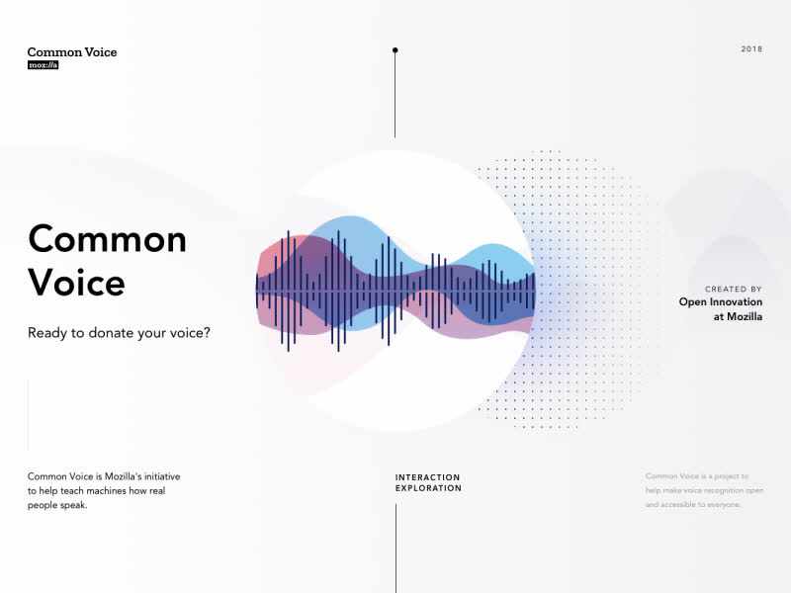

Applications
Voice assistants
Speech impairments
Transcribe and analyze
Example
Common Voice

Slide 7
Conclusion
DeeoSpeech
High Accurracy
Voice Assistance
Common Voice

Slide 8
Thank you
150K+
Active Users
Pro Plan

